Slide 1




BUILD
EASE
Designing Dreams, Building Futures

Slide 2

Our Team
Ayaz Hasan
20K-1044
Pankaj Kumar
20K-1607
Mohammad Ahmed Ahsan
20K-0343

Slide 3
Content
Company description
Industry Analysis
Market Analysis
Marketing Plan
Design and Development Plan
Operations Plan
Management Team & Company Structure
Financials Projection

Slide 4

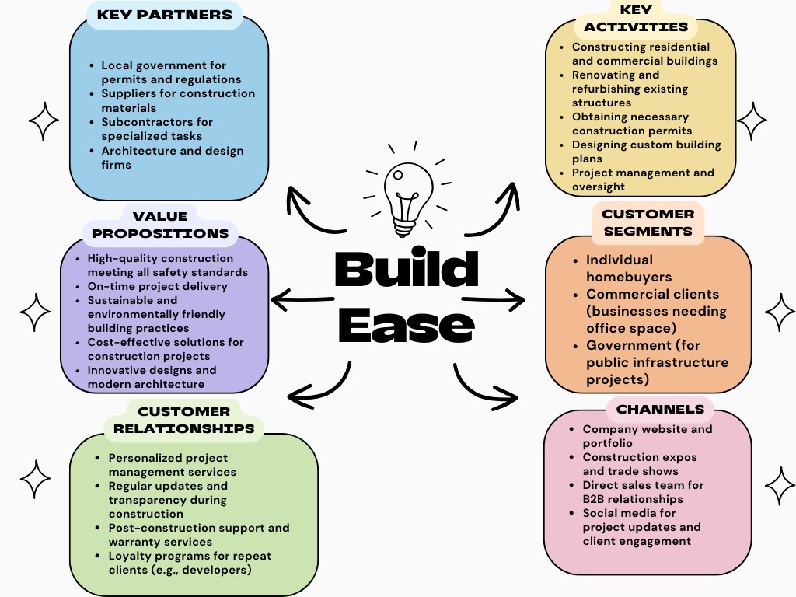

Business Model

Slide 5


COMPANY DESCRIPTION
The construction industry is a very complex industry that is facing problems inluding :
Lack of Information of Private Contractors.
Determine the contractors with bad reputation.
Lack of communication.

Slide 6

PRODUCT AND SERVICES
To solve this problem, Build Ease Provide the central Hub for:
Contractors Listing
Project Tracking
Communication b/w Client & Contractors
Real Time Data
Cost Estimate

Slide 7
Industry Analysis
1. Industry Size
2. Growth Rate
Karachi construction market size was $17.4 billion in 2022. It is projected to achieve an average annual growth rate (AAGR) of more than 5% .
Construction sector is estimated to expand by a staggering 92 percent in seven years from Rs1,409 billion in FY2021 to Rs2,706 billion by FY2029, at an annual rate of 11.8 percent.

Slide 8
Industry Analysis
3. Nature of Participants
4. Key Success Factors
Private Contractors
to small and medium enterprises (SMEs)
Clients
Material Providers
On Time-Delivered
Real Time Project Tracking
Cost Management
Real Time Material Data

Slide 9

Market Analysis
Market Segmentation and Target Market Selection
1. Project Type: Residential, commercial, infrastructural, and industrial.
2. Client Type: Governmental bodies, private project owners, and small to medium enterprises (SMEs).
3. Project Scale: Small-scale renovations, medium-sized buildings, and large-scale developments.

Slide 10
Market Analysis
Buyer Behaviour
Buyers in this segment typically exhibit behavior influenced by factors such as cost-efficiency, quality of service. They prefer solutions that offer clear communication, real-time updates, and detailed record-keeping to minimize errors and delays

Slide 11
Market Analysis
Competitor Analysis
Estimate
Local Startup: Focuses on budget management tools but with limited project tracking and resource management features.
BuildEase Construction Solutions aims for annual sales of 15-30 million by the end of year three

Slide 12



Marketing Plan:
Price
subscription-based pricing with different tiers.basic tier for small-scale projects, a professional tier for medium projects, and an enterprise tier for large-scale or multiple ongoing projects
Promotions
Digital Marketing, Content Marketing,, Webinar and Workshops, Industry Conferences

Slide 13





Sales Process
01
02
03
04
05
06
Lead Generation
Proposal and Negotiation
Closing
Follow-up and Feedback
Initial Contact
Demonstration

Slide 14
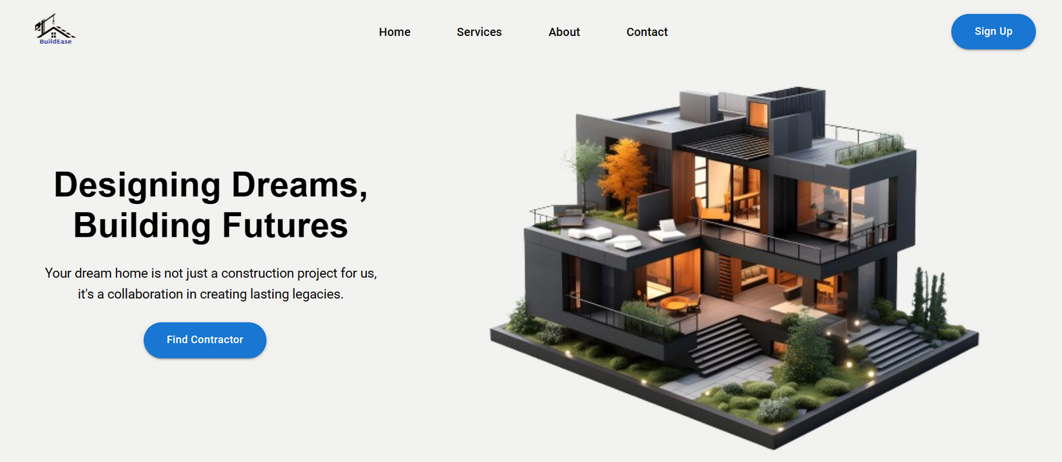
Design And Development
Wireframes and mockups for the website have been created.
Frontend Completed using React Js
Backend Completed using Flask Python
Cost estimate and Real Time Data Feature Created

Slide 15
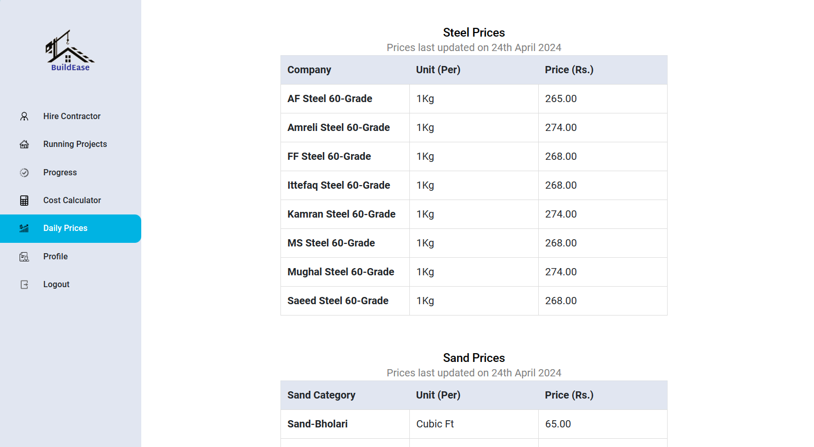

Slide 16
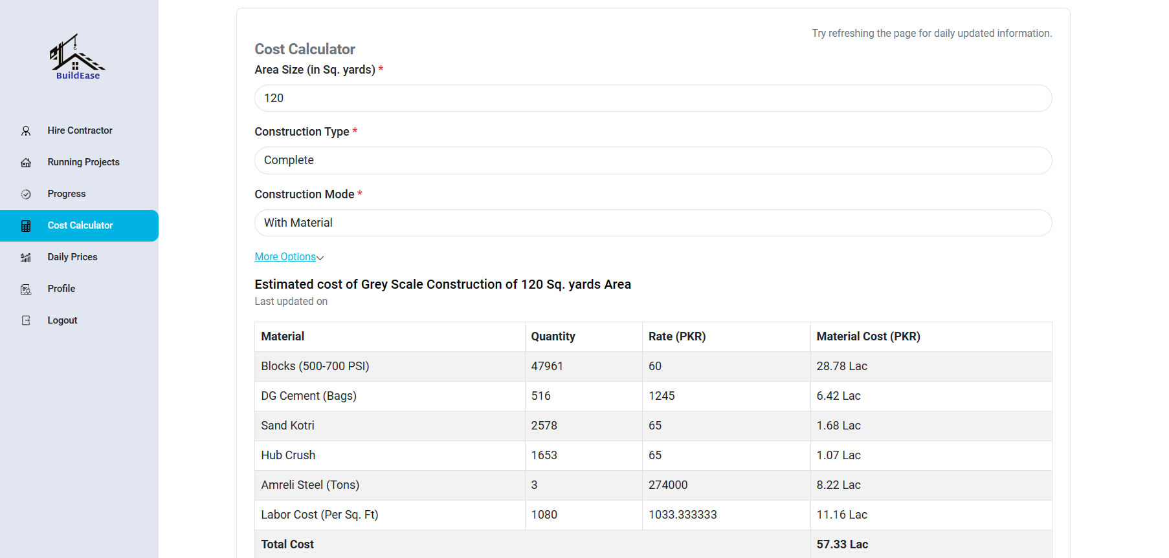

Slide 17

Operations Plan
Business Location: Karachi
leased offices, or remote work setups depending on budget and flexibility needs.
Provide necessary hardware such as computers, laptops, monitors, and mobile devices for team members.
Set up dedicated areas for team meetings, brainstorming sessions

Slide 18
Management Team
Head of Development:
Marketing Manager
Finance Manager
Founder
The visionary leader responsible for setting the overall direction and strategy of the company.
Oversees the technical aspects of website development, including architecture, infrastructure, and software development.
Develops and executes marketing strategies to promote the website platform and attract users.
Handles financial planning, budgeting, and accounting activities for the company.

Slide 19
Company Structure
Cross-Functional Teams
Agile Framework
Department
Divide the company into functional departments based on key areas of focus such as development, operations, marketing, finance, and customer experience.
Individuals with diverse skills and expertise.
Implement agile methodologies such as Scrum or Kanban to organize work into manageable iterations or sprints.

Slide 20
Financial Projections
Sources of Funds
Uses of Funds
Assumptions sheet
Pro forma Income Statements
personal investments, bank loan, Government Grants
development costs, software tools and licenses cost, Advertising expenses
Assumptions regarding pricing strategy, discounts, and promotions.
Economic conditions, inflation rates, and currency exchange rates.
Projected cash inflows and cash outflows from subscription fees and funding rounds. development, marketing, payroll, and operational costs.

Slide 21
THANK YOU

